Slide 1

www.walthamforest.gov.uk
Education Performance & Information
Schools Admin Data Group
20th September, 2017

Slide 2
www.walthamforest.gov.uk
Education Performance & Information
AGENDA
1.15 – Welcome & Introduction
1.20 – Early Years
1.35 – School Census – Primary
1.50 – General Q&A
2 – Break (Secondary Colleagues Arrive)
2.25 – Welcome & Introductions
2.30 – School Census
2.45 – Academy Checking Service
2.50 – Childcare Data
3.00 - Funding
3.15 – School Workforce Census
3.25 – Exclusions
3.30 – Meeting closes for Primary Schools

Slide 3
www.walthamforest.gov.uk
Education Performance & Information
Early Years Provider HUB (30 hours checker)
Katre Sikka, Childcare Participation Officer
childcare@walthamforest.gov.uk
0208 496 3566

Slide 4

Early Years Provider HUB (30 hours checker) - eyp.walthamforest.gov.uk
  As a School – what can I do?
  Registering to the EYP HUB
  Create and manage School users
  Edit School profile
  Perform 30 hours code validation
  Early Years Provider HUB – future developments

Slide 5
  Registering on the EYP HUB – Step 1
Invitation to register was sent out to the Schools on 24th August 2017
The email was sent to School’s Ofsted registration email address
“Invitation to register on EYP HUB” from
no-reply@oohubmail.com.
Please email us on childcare@walthamforest.gov.uk if your School has not received the invitation email.
Follow the instructions in the invitation email to complete your registration.

Slide 6

Registering on the EYP HUB – Step 2: Choose your password

Slide 7
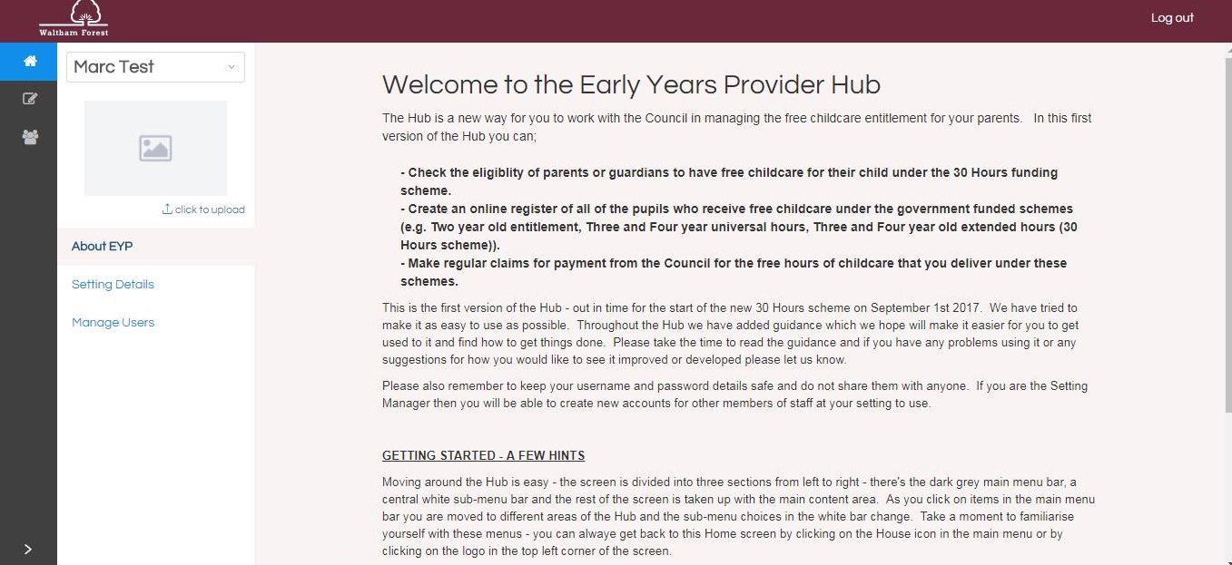
Early Years Provider HUB (30 hours checker)

Slide 8
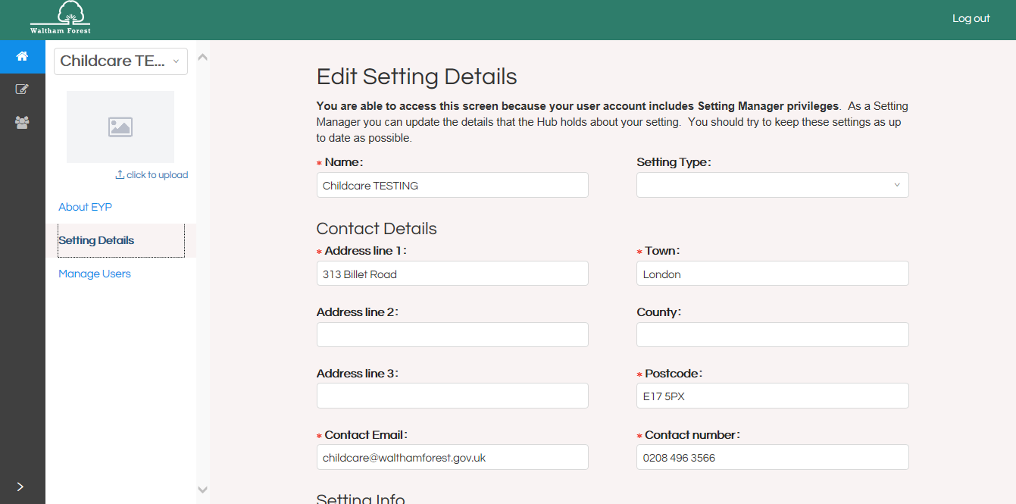
  Step 3: Edit School Profile

Slide 9
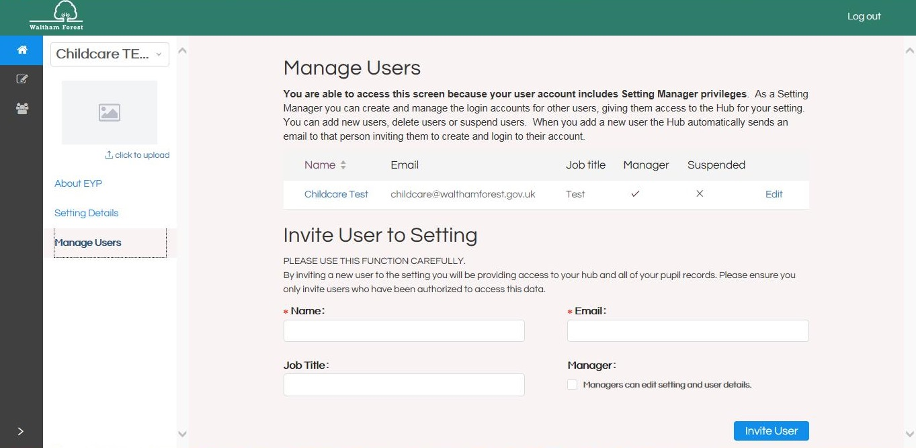
  Step 4: Create and Manage School Users

Slide 10
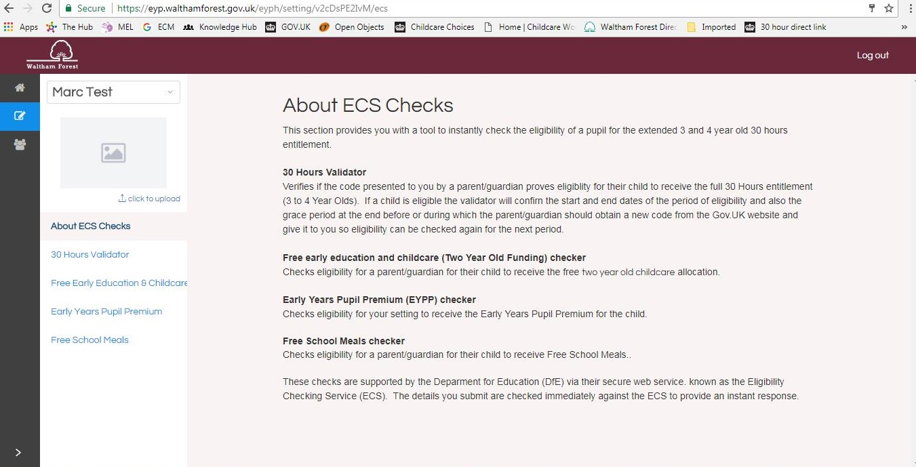
Early Years Provider HUB (30 hours checker)

Slide 11
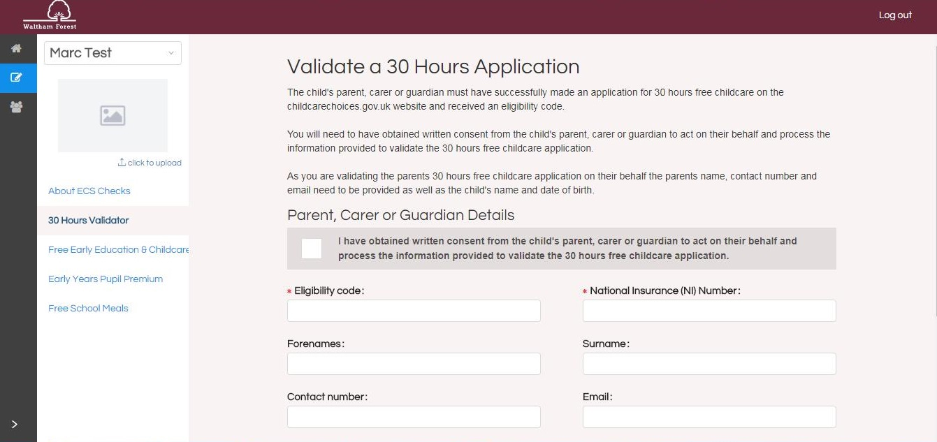
Step 5: Perform 30 Hours Code Validation Check

Slide 12
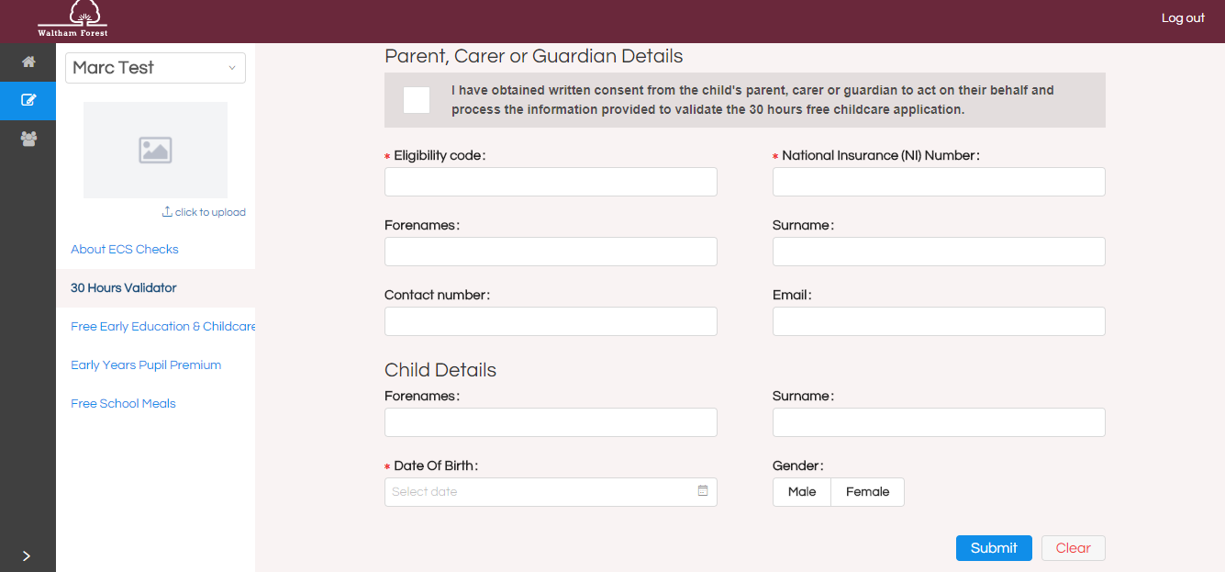
Step 5: Perform 30 Hours Code Validation Check (Part 2)

Slide 13
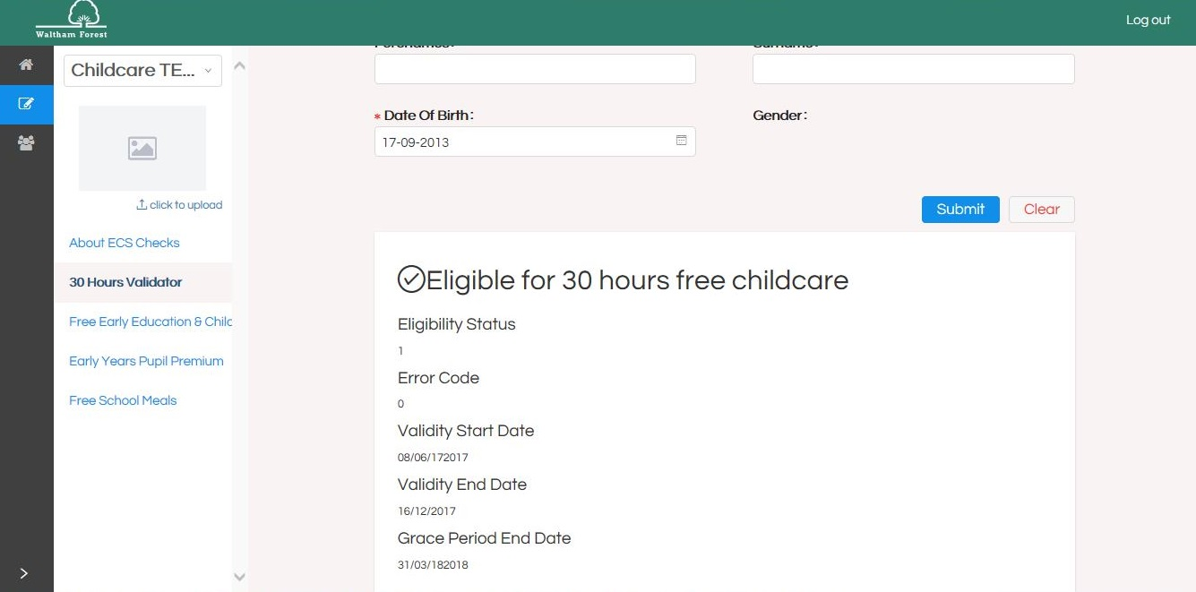
Step 5: Perform 30 Hours Code Validation Check (Part 3)

Slide 14
Early Years Provider HUB – Future Developments
Re-checking the validity of the 30 hour codes
Reporting function
2 year old checker and EYPP checker

Slide 15
www.walthamforest.gov.uk
Education Performance & Information
Questions / Comments?

Slide 16
www.walthamforest.gov.uk
Education Performance & Information
School Census (Primary)
Jane Xavier-Small, Education Performance & Information Team

Slide 17

Primary and All-through amendments to Summer 2017 School Census
Notes:
Between the spring and summer 2017:
The number of amendments made to part-time flag more than halved from 212 to 90
Amendment to universal lunches fell from 40 to two.
Amendments to the language field down from 107 to 20

Slide 18
Primary and all-through Amendments to Spring 2017 School Census

Slide 19
BEFORE you submit your Census…
Please check the part time/full time status of all nursery and reception pupils before you submit the return
Notes:
Part-time
part-time details is mainly relevant to Nursery phase. However, any pupil can be marked as part-time if their attendance is less than 10 sessions per week.
When recording part-time details, a minimum of a Start Date needs to be entered in the Part Time Details section.

Slide 20
Changes from 2016 to 2017 school census
New Data Items
Extended childcare hours - this new field records the take-up of the additional 15 hours of childcare
30 hour code indicator - The 30 hour code indicator confirms eligibility of working parents to access the additional 15 hours extended child care
Disability access fund (DAF) indicator -new field records whether a 3 or 4 year old in nursery receives disability living allowance
2-year-old basis for funding - records the basis on which a 2-year-old has been funded
Change to decimal places
Recording hours funding hours changed from 1 to 2 d.p.
Notes:
Extended childcare hours - are collected for:
a sub-set of 3 and 4 year olds who are in
‘E1’, ‘E2’, ‘N1’ or ‘N2’ only and
who have working parents with a valid 30-hour code.
The 30-hour code indicator - is
an 11-digit integer that is required for pupils who claim extended childcare hours.
The code confirms the eligibility of working parents to receive the additional 15 hours of extended childcare.
The disability access fund (DAF) records eligible pupils aged 3 and 4, that meet the following criteria:
Receiving child disability living allowance; AND
the child receives free early education.
2-year-old basis for funding
Records the basis under which a 2-year-old has been funded whilst taking up a place in the school. Either
Economic criteria,
High-level SEN or disability or
Looked after or adopted from care.

Slide 21
www.walthamforest.gov.uk
Education Performance & Information
Questions / Comments?

Slide 22

School Census Prize Giving
  We promised a prize to the schools that submitted their School Census on day 1
  Well done to…
  Woodford Green Primary
  St Joseph’s Catholic Infants’
  Gwynn Jones Primary
  Coppermill Primary
  St Patrick’s Catholic Primary
  Mayville Academy (Auth on day1)

Slide 23
Assessment data collection
  We would also like to thank you all for getting the assessment data to us last term and for answering our queries

Slide 24
The award for submitting all assessment files first goes to …
Sybourn Primary School

Slide 25
Q&A
Any issues to discuss now?
Anything you would like on the agenda in future?
Please fill in your Evaluation sheet before you go

Slide 26
www.walthamforest.gov.uk
Education Performance & Information
AGENDA
2.10 – Break (Secondary Colleagues Arrive)
2.25 – Welcome & Introductions
2.30 – School Census
2.45 – Academy Checking Service
2.50 – Childcare Data
3.00 - Funding
3.15 – School Workforce Census
3.25 – Exclusions
3.30 – Meeting closes for Primary Schools
3.35 – Primary to Secondary Transfer Data
3.40 – School Census – Secondary
3.50 – Careers
4.05 – General Q&A
4:15 – Meeting closes for Secondary Schools

Slide 27
www.walthamforest.gov.uk
Education Performance & Information
DIARY DATES
School Census:
Autumn Headcount Date = Thurs 5th Oct ’17, Deadline = Tues 10th
Spring Headcount Date = Thurs 18th Jan ’18, Deadline = Tues 23rd
Summer Headcount Date = Thurs 24th May ’18, Deadline = Tues 29th
Academies follow DfE deadlines – please submit well in advance of final DfE deadline
School Workforce Census:
Headcount Date = Thurs 2nd Nov ’17, Deadline = Tues 7th
Reading Project Data (Current Y2):
Autumn term data in by 11th January
Spring term data in by 29th March

Slide 28
www.walthamforest.gov.uk
Education Performance & Information
TEAM NEWS
Linda Cambridge is leaving this week
Linda has done a lot of work to support admissions and governors with their use of the central pupil database. Recently, she has created a report in ONE which should remove the need for most schools to submit ‘weekly returns’ to admissions. We are grateful for her contribution over the years
Saadane Benoumessad will provide temporary cover from next week
We have made permanent appointment of Jared Robinson, who we hope will join us in a few months

Slide 29
www.walthamforest.gov.uk
Education Performance & Information
School Census (All)
Jane Xavier-Small, Education Performance & Information Team

Slide 30
Amendments to school census returns
Notes:
The most recent school census (summer) return, show the fewest amendments since we began examining changes.
We have been recording the changes that are made termly to school census returns. The graph shows:
The last census (summer) show:
summer 2017 fewest amendments in our time series ; (Thank you!)
Some data topics amended such as universal lunches has seen a dramatic fall in the number of records that are amended.
Whilst far fewer part-time flags are being changed, there is still room for greater accuracy.
We must not be complacent because the pattern shows amendments are cyclical varying according to term.
Historically of the termly census autumn has the most amendments.

Slide 31
Changes from 2016 to 2017 school census
New Data Item
Establishment unique reference number (URN) –
The establishment unique reference number as held on the department’s EduBase system will also be collected on the school census return
Notes:
The URN records the 6-digit establishment unique reference number as held on the department’s EduBase system. This assists in the identification of establishments.

Slide 32
Changes Existing Data Items
Pupil level collection
The proficiency in English indicator has been amended to a spring collection only
  (BUT don’t forget to collect and input data for all pupils before January)
SEN unit indicator and resourced provision indicator have been amended to be collected each term
  SEN Unit - taught mainly in separate classes
  Resourced Provision - places are reserved at a mainstream school for pupils with a specific type of SEN, taught mainly within mainstream classes, but requiring a base and some specialist facilities around the school
General amendment
The school phase marker for PRUs

Slide 33
LOOKING FORWARD TO AUTUMN CENSUS…
Remember to do a dry run to remove error/queries before Census day
Use the summary report to check for other anomalies
If you use SIMS, remember to backdate the start date in the data item history to at least the day of census otherwise changes to some data items such as language or SEN won’t be picked up on your census return
Notes:
Remember for some data items such as language if you add the data after census date, remember to backdate the start date of the language to at least the day of census otherwise it won’t be picked up on your census return.

Slide 34
Common errors and issues – things to look out for
First Language
  First Language other than English should be recorded where a pupil was exposed to the language during early development and continues to be exposed to this language at home or in the community
Exclusions
  Remember collected 2 terms in arrears - check
Enrolment Status
  Pupils cannot be solely registered (enrolment status code C) at two schools
  The schools should speak to each other and agree which will be main and which subsidiary dual registration
Notes:
Enrolment Status
Main issue is with pupils two appear on more than one school census return. Please note the advice given about resolving duplicates. If the pupil should currently be on roll at both schools please ensure that the dual enrolments match or if the pupil should be solely registered at one school they are off roiled by the other school.
If the pupil’s registration status has changed from when they were previously on-roll, their enrolment status should be changed via Routines |Pupil | Change Enrolment Status.
Language
A First Language other than English should be recorded where a pupil was exposed to the language during early development and continues to be exposed to this language at home or in the community.

Slide 35
Known issues FROM DfE
Error 3070 and 3075 for pupils with code ‘SVK’ in Nationality and country of birth - These errors can be ignored where SVK is used as they will disappear when the return is loaded to COLLECT
Error 1852 may trigger incorrectly for pupils with zero funded hours in schools systems. This error can be ignored as it will disappear once the return is loaded to COLLECT
Nursery schools (phase NS) with pupils aged 4 in Reception a validation error may incorrectly trigger requesting funded hours etc.
School Summary:
Table 2 Pupils on roll by age and gender – age calculation incorrect, pupils show a year below actual age
An error in the wording displayed for pupils aged 5, the date of birth range should be ‘01/09/11-31/08/12’ and not ‘01/09/2012 and later’
Table 16 - The unauthorised absence codes have been omitted for pupils aged 4 years as at 31/08/2016 (however, as pupils are not compulsory school age so the DfE do not expect schools to be affected by the issue)
Table 23 – Universal meals - the age calculation is incorrect for pupils with NC year X
Notes:
The following known issues are due to errors made in the XSLT which the department issues to software suppliers. - These errors can be ignored where SVK is used as they will disappear when the return is loaded to COLLECT.
Error 1852 may trigger incorrectly for pupils with zero funded hours in schools systems. This error can be ignored as it will disappear once the return is loaded to COLLECT.
The age calculation is incorrect in the XSLT and therefore pupils are shown on this table in a year below their actual age.
There is also an error in the wording displayed for pupils aged 5, the date of birth range should be ‘01/09/11-31/08/12’ and not ‘01/09/2012 and later’
The age calculation for pupils with NC year X is incorrect. This could have implications for recording Universal Infant Free School Meals. Thankfully this information is recorded on a COLLECT portal report and it is available for schools to run via COLLECT once their return has been uploaded to COLLECT. . UiFSM.

Slide 36
Funding calculations
The data collected via the 2017 autumn school census will be used in:
the calculation of the schools block of the dedicated schools grant
the universal infant free school meals funding
Post 16 data collected via the autumn school census will be used by the education and skills funding agency (ESFA) to calculate post 16 funding allocations for schools with sixth forms
The DfE will not double fund duplicate UPNs in the School Census. If the duplicates are not resolved, the full time equivalent of the pupil is divided between the schools
Details of the funding arrangements for the 2018-19 financial year are available at: https://www.gov.uk/guidance/pre-16-schools-funding-guidance-for-2018-to-2019
Notes:
As in previous years, the autumn school census will be used to fund the schools block of the dedicated schools grant
The school block pupil number counts are derived primarily from the October school census.

Slide 37
REMINDERS to AVOID DUPLICATES
  Where a pupil on your roll is attending a school elsewhere, please make every effort to locate and off roll them in advance of census day
  If pupils are on roll at 2 schools:
  Agree enrolment status with other school (main or subsidiary)
  Agree review date (e.g. for trial period)
  Agree if one school can off roll and the other single register
  Remember to use attendance code D for the times the child is expected to be at the other school
  If a student has attended a previous school, please obtain the CTF from the school and check whether they have a pre-existing UPN.
  Speak to Jane or Erica if unable to get UPN
  Academies – look at duplicate reports in COLLECT regularly

Slide 38
www.walthamforest.gov.uk
Education Performance & Information
Data Protection
Jo Bell, Education Performance & Information Team

Slide 39
CHANGES TO DATA PROTECTION
On 25th May 2018 General Data Protection Regulations (GDPR) will be replace the Data Protection Act 1998
Data Security/Safeguarding of personal data is paramount
  Policies & Training for staff?
Schools must provide clear, accessible Privacy Notices to inform parents, pupils and staff:
  What data is collected about them
  How the data is processed
  What the lawful basis is for processing
  How long it will be retained
  Who the data is shared with
  Why the data is shared

Slide 40
CHANGES TO DATA PROTECTION
We sent current Privacy Notice template to schools last year
DfE are revising the templates shortly – we will add LA info and send them to you when they are released
Schools must review the content and ensure it covers local circumstances, as the school will collect data that is not solely used for the DfE data collection processes – e.g. local info for pupil achievement tracking or use of CCTV data
Notes:
be put on the school website for parents,. Whilst privacy notices do not need to be issued on an annual basis - as long as new pupils and staff are made aware of the notices, the notices have not been amended and they are readily available electronically or in paper format – best practice would be to remind parents of the notices at the start of each term (within any other announcements / correspondence to parents) and it is important that any changes made to the way the school processes personal data are highlighted to data subjects.

Slide 41
CHANGES TO DATA PROTECTION
Once content is agreed, then publish so staff, parents and students can access
  Include as induction pack for staff & put on noticeboard/intranet
  Put on website for parents and pupils – make them aware of notice at the start of each term in newsletters etc, highlighting changes to the way the school processes personal data
Notes:
be put on the school website for parents,. Whilst privacy notices do not need to be issued on an annual basis - as long as new pupils and staff are made aware of the notices, the notices have not been amended and they are readily available electronically or in paper format – best practice would be to remind parents of the notices at the start of each term (within any other announcements / correspondence to parents) and it is important that any changes made to the way the school processes personal data are highlighted to data subjects.

Slide 42
Certain data items can be refused…
Remember that some data items can be refused by the parent (or pupil if they are old/mature enough)
Ethnicity
Language
Country of Birth
Nationality
Service Child Indicator
These must be reported as declared by the parent/pupil
For nationality and Country of Birth schools must
  ensure that parent/pupil is aware of right to decline to provide
  Ensure parent/pupil is aware of right to retract information returned in a previous census

Slide 43
www.walthamforest.gov.uk
Education Performance & Information
Questions / Comments?

Slide 44
www.walthamforest.gov.uk
Education Performance & Information
Academy Census Checking Service
Jo Bell, Education Performance & Information Team

Slide 45
ACADEMY School census returns
Academies submit their own census returns to the DfE
Academy data is released to LAs when it is authorised by the DfE
We have noticed that many academy returns are not being authorised until the day the COLLECT blade closes
This suggests that there are errors/queries outstanding or that explanation notes are not sufficient
There are also errors that we find on the data that we get, such as unresolved duplicates, missing exclusions, part time children listed as full time…
We are already supporting maintained schools to help get returns accurate. We would like to share our expertise with academies

Slide 46
New Academy Checking service
We piloted a checking service with academies last term
2 options have been added to our traded service:
Silver Service
- You would extract your data from COLLECT and securely send it to us on Anycomms+. We run additional checks and send you a report on Anycomms+
- We are available via email and phone helpline to explain the queries in your report
- If you have any queries in COLLECT, we can advise on appropriate notes to be added
- You will send us duplicate reports and we will advise you of changes that need to be made on your return and what you need to do regards
other schools/academies to resolve the issue
The academy will need to upload their return to COLLET in reasonable time for checks to be made before final DfE deadlines.
Gold Service – same as silver plus…
-We extract your data from COLLECT (if you give us a log-in).
-If changes need to be made, we will make up to 10 on your behalf. Any more, it is best to resubmit the return. You would need to make the amendments on your MIS
- If you would like, we can write COLLECT notes on your behalf
-We will run duplicate reports for you and advise you of changes that need to be made on your return. We can contact other LAs/academies on your behalf and let them know that changes need to be made.
[Note that although we would talk other academies through the changes that need to be made and how to do them in COLLECT, we would not be responsible if that academy refused to make the change or ignored the request. We would ensure you were aware of any outstanding before the DfE deadline so that you can escalate the request]

Slide 47
New Academy Checking service
If you would like to take advantage of this support,
sign up at WFOnline
Costs have been kept to a minimum
  Silver £45 /term
  Gold £80 /term

Slide 48
www.walthamforest.gov.uk
Education Performance & Information
Questions / Comments?

Slide 49
www.walthamforest.gov.uk
Education Performance & Information
Childcare Data – Spring Census Requirements
Lindsay Jackson, Business Development Consultant

Slide 50
January Census
Local Authorities have a duty to ensure that there is sufficient childcare for children aged 0-14 (or up to 18 for disabled children)
From January 2017, levels of childcare delivered via schools has been monitored annually via the January Census.
This will be used to:
Monitor whether current DfE strategies has enabled sufficient childcare or whether further measures need to be considered;
Enable Local Authorities to gain a clearer map of childcare sufficiency across the borough; and
Provide comprehensive information to parents via the new school performance tables on childcare offered by schools.
Notes:
To ensure there is sufficient childcare available to meet the needs of: disabled children; children from families in receipt of Universal Credit for childcare; children with parents who work irregular hours; children aged two, three and four taking up early education places; school age children; and children needing holiday care.
School performance tables include comprehensive information on what childcare primary and secondary schools offer – from nurseries to after school and holiday provision.
This aims to assist parents in finding and accessing as many high-quality options as simply as possible.

Slide 51
Which schools have to provide this information?
  All Nurseries, Primaries, Secondaries, All-through, Special Schools and PRUs must provide information on the provision of, or signposting to, four types of childcare:
  Before school;
  After school;
  Holiday; and
  Under 5s.
Notes:
4.2.23 Childcare facilities indicator [For: PRU / AP only] Indicates whether the PRU / AP has childcare facilities.

Slide 52
Before School childcare service
Definition: Guaranteed, regular service delivered when school is open. Providing safe secure place for working parents to leave their child before school opens formally. Takes children to their classes when the school opens. May be a breakfast club or offer structured activities.
Census Question: Is there a regular before school childcare service on the school site?
If Yes | If No
What time does it open? How many places? Who provides the service Is it open to children from other schools (with transfer included)? | Is there a regular off-site service that the school promotes or signposts parents towards?

Slide 53
After School childcare service
Definition: Guaranteed, regular service delivered when school is open. Providing safe secure place for working parents to leave their child after the school day finishes. Picks up children from their classes until collected by their parents. May include: structured activities, free play, food, homework support or a mixture of these. May be integrated into other school activities.
Census Question: Is there a regular after school childcare service on the school site?
If Yes | If No
What time does it close? How many places? Who provides the service? Is it open to children from other schools (with transfer included)? | Is there a regular off-site service that the school promotes or signposts parents towards?

Slide 54
Holiday childcare service
Definition: A service that is open for at least 8 hours a day usually Mon-Fri during school holiday periods. May not cover all holiday but should provide a useful service to working parents. Does not include activities that are only available for morning or afternoon sessions, although the service may be integrated with such offers. As offers may change only answer for current arrangements.
Census Question: Is there a holiday childcare service or scheme offered on the school site?
If Yes | If No
What time does it open? What time does it close? How many weeks is the service open? How many places? Who provides the service? Is it open to children from other schools? | Is there an off-site service or scheme that the school promotes or signposts parents towards?

Slide 55
Under 5s childcare service
Definition: This is for nursery (or pre-school) children aged between 0-4yrs old and not in reception class. This childcare service must be one that parents can use for at least 9 hours a day if they choose to. Do not include provision that is only available during the school hours or where children can only attend for a morning or afternoon session.
Census Question: Does the school have an on-site offer of regular childcare for children aged under 5 (between 0 and 4) for more than 9 hours/day?
If Yes | If No
What time does it open? What time does it close? For how many weeks is it open? How many places? Who provides the service? | Is there a regular off-site service that the school promotes or signposts parents towards?

Slide 56
Definitions, notes and code sets
If Yes
For how many weeks is it open? | For holiday childcare you should enter the total number of weeks offered across all holiday periods (ie 1wk at Easter and 4wk in summer = 5wks, if covering all holidays with the exception of Christmas wk you should enter 13wks.)
 | For Under 5s childcare: you should include the number of weeks that the service operates choosing between 1-38wks. Under 5 provision delivered over the holiday periods should be recorded under the holiday childcare service.
How many places? | The maximum number of children the service can simultaneously provide care for (capacity)
Who provides the service? | Either: SCH SIP or OTH | School – service is delivered directly by the school by members of staff employed by the school School in partnership with another organisation – could be another school, private or voluntary organisation Organisation rents or leases space in the school – no involvement by the school in delivery or running

Slide 57
Definitions, notes and code sets
If your school answers NO to having one of the childcare services on your site you will need to answer one of the following:
YF | Yes there is a regular of-site service that we promote/signpost to that we have formal arrangements with to provide childcare to our pupils, including transport from their site to the school
YL | Yes we provide parents with a list of other local providers who can provide childcare and transport to our school
N | We have no arrangements for off-site provision
U | We do not know of any off-site provision arrangements

Slide 58
Support with signposting or finding childcare partners
Families can search for local childcare providers and activities for young people on the Waltham Forest Directory: https://directory.walthamforest.gov.uk
Schools can:
Embed this link to their school websites; and
Download lists of childcare providers delivering in their area to provide to parents.
For further information or guidance on doing this contact Katre Sikka, Early Education and Childcare Participation Officer on:
Email: childcare@walthamforest.gov.uk
Telephone: 020 8496 3566

Slide 59
www.walthamforest.gov.uk
Education Performance & Information
Questions / Comments?

Slide 60
www.walthamforest.gov.uk
Education Performance & Information
Funding Game
Jo Bell, Education Performance & Information Team

Slide 61
School census FUNDING
A [used for funding] marker has been added in the DfE’s School Census guidance against data items that contribute to funding calculations
Do you already know which are used…?

Slide 62
School census FUNDING
Yes
No
Pupil Date of Birth
Pupil Gender
Free School Meal Eligibility
Class Size
Pupil Address
Pupil Surname
Language Code
Ethnicity
In Care (not in Census!)
Post-Looked After Arrangements
SEN Provision
Member of SEN Resourced Provision
Exclusion
Enrolment Status
These are just some examples – see the DfE guidance for more information
Just because something isn’t used for funding, doesn’t mean it is not important

Slide 63
www.walthamforest.gov.uk
Education Performance & Information
Questions / Comments?

Slide 64
www.walthamforest.gov.uk
Education Performance & Information
School Workforce Census
Louise Jelks, Education Performance & Information Team

Slide 65
School Workforce census
Changes for 2017
Only minor textual changes have been made to the School Workforce 2017 specification
Common Errors and Queries
Staff with no contract information
Teachers with no teacher reference number
Qualification not recorded for teachers: first degrees and teacher qualifications
Missing additional payments
Missing absences or overlapping dates

Slide 66
Recommend Regularly Update
Absences
Contracts
Pay - including additional payments
Destinations and Origins
Qualifications
Personal details - including NI for agency teachers there for over 28 days

Slide 67
www.walthamforest.gov.uk
Education Performance & Information
Questions / Comments?

Slide 68
www.walthamforest.gov.uk
Education Performance & Information
Exclusions Data
Jason Thirley, Education Performance & Information Team

Slide 69
Exclusions Data
A data issue concerning Exclusions Data being reported to LBWF has come to light in recent months
This has been caused when an exclusion is created and subsequently appealed or dropped
If the exclusion is created on SIMS this is transferred through B2B to Capita ONE at LBWF. If the exclusion is appealed or dropped, some Schools are deleting the exclusion from SIMS instead of withdrawing or reinstating
When the exclusion is deleted in SIMS there is no automatic process in B2B to delete the exclusion and these stay as ‘ghost’ exclusions on Capita ONE

Slide 70
Exclusions Data
Please could schools ensure that they are closing exclusions and not deleting them from SIMS
If you do need to delete an exclusion for a legitimate reason, please notify us (securely) and we will update Capita ONE accordingly

Slide 71
www.walthamforest.gov.uk
Education Performance & Information
Questions / Comments?

Slide 72
www.walthamforest.gov.uk
Education Performance & Information
Primary to Secondary Transfer Data
Jo Bell, Education Performance & Information Team

Slide 73
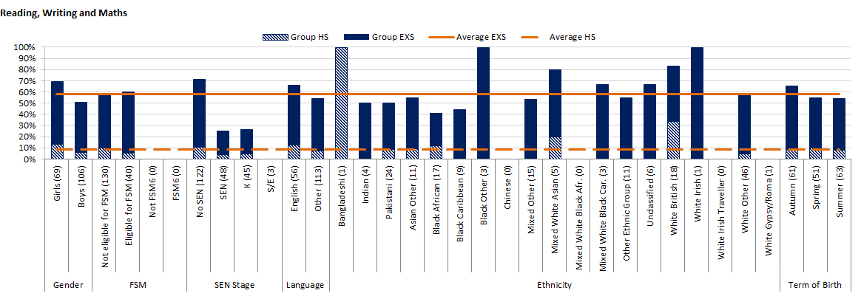
Pilot of new service
At the end of the summer term, we sent secondary schools a new analysis of KS2 data for the new intake matched (as far as possible) to contextual factors
The idea is that schools get analysis of individuals and groups that may be under-performing before pupils arrive

Slide 74
Pilot of new service
Was the service useful?
What would you like to change?
Would an update in September be desirable?
Would schools buy in next year?

Slide 75
www.walthamforest.gov.uk
Education Performance & Information
Questions / Comments?

Slide 76
www.walthamforest.gov.uk
Education Performance & Information
School Census (Secondary)
Jane Xavier-Small, Education Performance & Information Team

Slide 77
Secondary amendments to Summer 2017 School Census
Notes:
Between the spring and summer 2017:
The number of amendments made to part-time flag more than halved from 212 to 90
Amendment to universal lunches fell from 40 to two.
Amendments to the language field down from 107 to 20

Slide 78
Secondary amendments to Spring 2017 School Census

Slide 79
Checklist for Secondary Phase pupils
  Check and/or obtain Unique Learner Numbers for all students aged 14 or over on census day
  Learning aims – For schools with 16-19 provision
  Youth support services / Connexions agreement should be recorded either ‘Yes’, ‘No’ or SNR (Sought No Reply)
Notes:
Unique Learner Numbers
Learning Records Service (previously known as the Managing Information Across Partners Programme) issues and maintains a ULN record for applicable students. ULNs can be obtained in one or more of the following ways:
•The DfE ULN service to upload a CTF file via a web page on the S2S website (http://www.education.gov.uk/researchandstatistics/datatdatam/s2s/a0064650/school-to-school-s2s).
•The Learner Registration Service Web Portal to obtain individual ULNs (https://www.gov.uk/government/collections/learning-records-service).
•The Key to Success website (https://www.keytosuccess.education.gov.uk/).
The Post 16 Learning Aims
Collected once a year for students for whom the school wishes to claim Post 16 funding from the Education and Skills Funding Agency (ESFA), who were/are in National Curriculum Year Group (Year Taught In) 12 or above during the period from 01/08/2016 to 05/10/2017.
It is important to ensure that the information entered in Course Manager is up-to-date and accurate before starting the return.
Youth support services Agreement (YSSA) status/ Connexions agreement
This data item should be returned for all pupils who are aged 12 and above (as at 31 August 2016).
If it is not completed the system will default to ‘unsought’. The return should be recorded as either: Obtained, Refused or Sought no reply.

Slide 80
www.walthamforest.gov.uk
Education Performance & Information
Questions / Comments?

Slide 81
School Census Prize Giving
  We promised a prize to the schools that submitted their School Census on day 1
  Well done to…
Burnside
Lammas
We would also like to thank schools for sending back provisional exam results in August…

Slide 82
The award for the first A Level results day form goes to …
Walthamstow academy

Slide 83
The award for the first GCSE results day form goes to …
George Mitchell

Slide 84
www.walthamforest.gov.uk
Education Performance & Information
Careers
Linda Leigh

Slide 85
www.walthamforest.gov.uk
Education Performance & Information
Questions / Comments?

Slide 86
Q&A
Any issues to discuss now?
Anything you would like on the agenda in future?
Please fill in your Evaluation sheet

